Slide 1
Electronic Voting System
EEE283L (Project)
Group: 01
Section: 02

Slide 2




Group Members
Md. Reshad Al Muttaki
Student ID: 22121091
Mushfeka Anika Bushra
Student ID: 21321070
Mohammad Fasiul Abedin Khan
Student ID: 22121091
Prapty Majumder Golpa
Student ID: 22121032

Slide 3
Problem Statement
Suppose you are an employee of a company and you are advised to develop a majority voting system for electing the 2023 Executive body of the company using logic gate, synchronous, combinational, and arithmetic circuit etc. 60 members in the company can cast votes. Consider you have 6 participants for three positions. The three positions are chairman, vice chairman, and secretary. Develop a system so that the majority vote wins and show the winner and vote counting in multiple 7-segment Displays.

Slide 4
Objectives of the Project
1 |  | Main Objective | Designing voting system for 6 participants and 60 voters
2 |  | Transparency | Displaying number of votes for each candidates
3 |  | Democracy | Selecting Chairman, Vice-Chairman and Secretary on the basis of number of votes
4 |  | Results | Displaying the results on the 7 segment display
5 |  | Clean & Fair | Ensuring fair election process

Slide 5
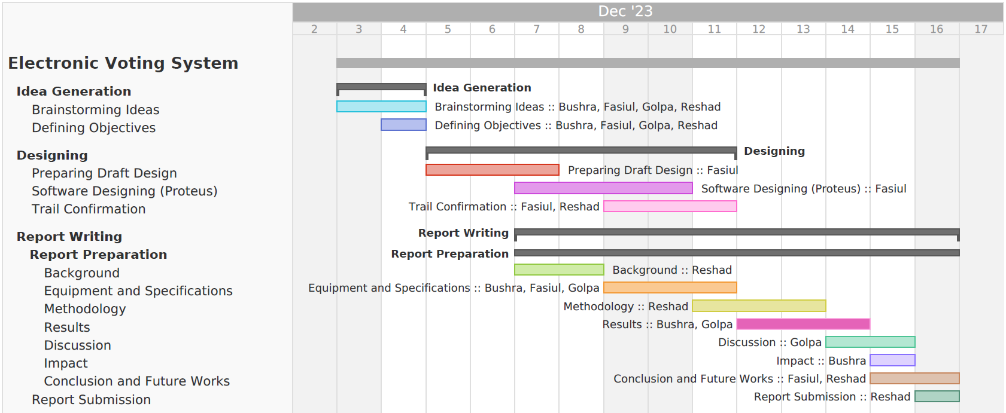
Gantt Chart

Slide 6
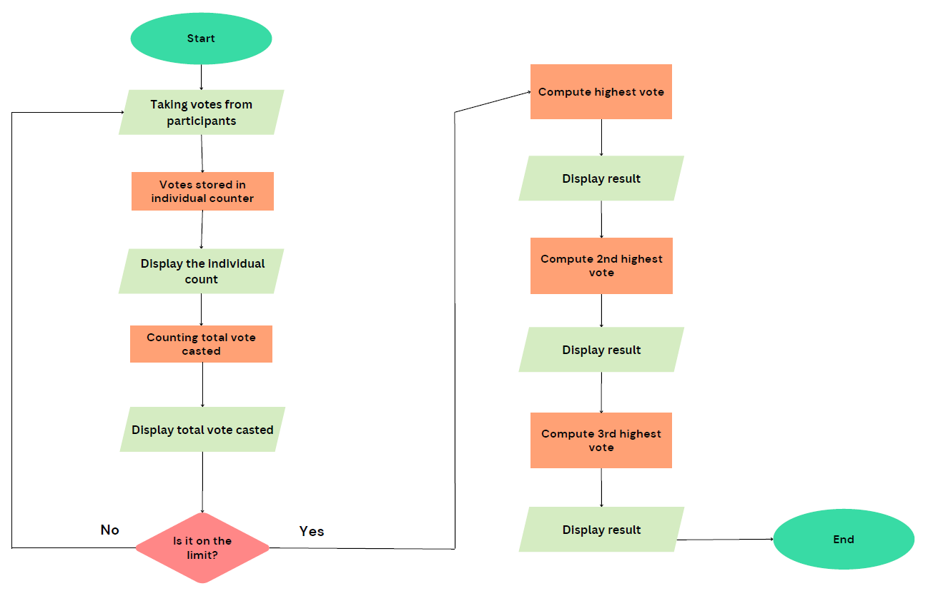
Workflow Diagram

Slide 7
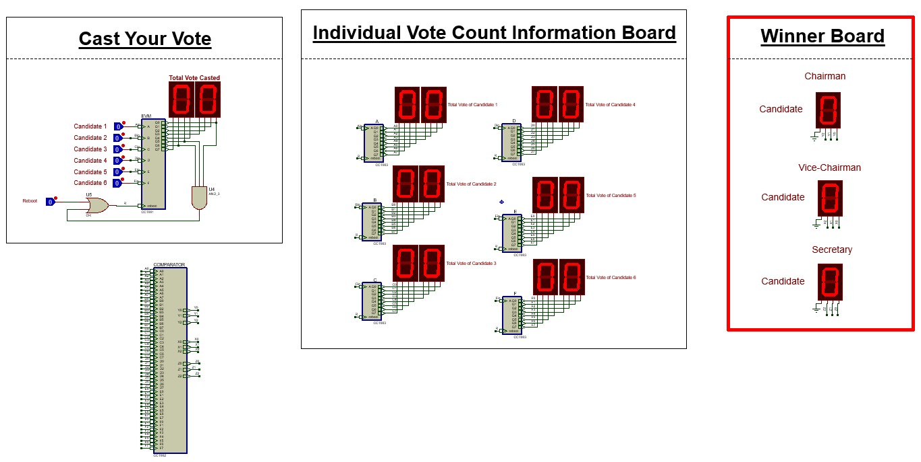
The Simulated Circuit Diagram

Slide 8
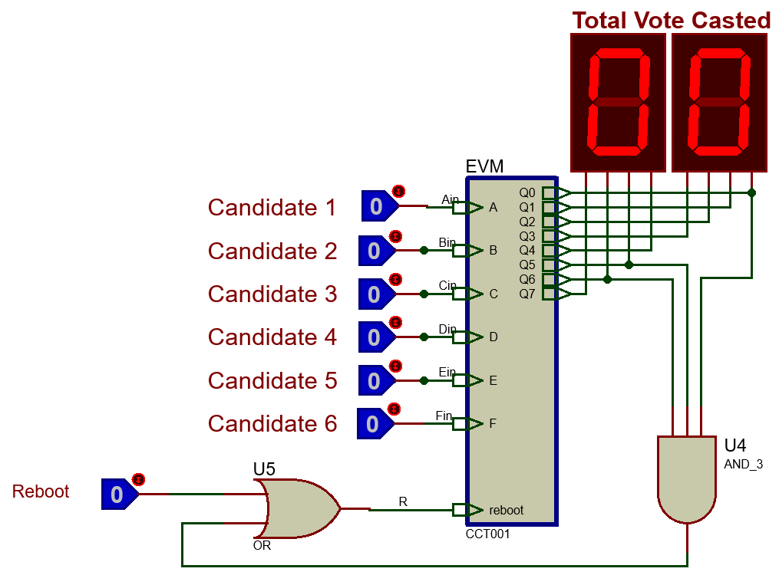
Components: EVM System
The machine takes the votes for each of the participants via Logic Toggles
The total number of Votes casted is shown on the
7 Segment Displays

Slide 9
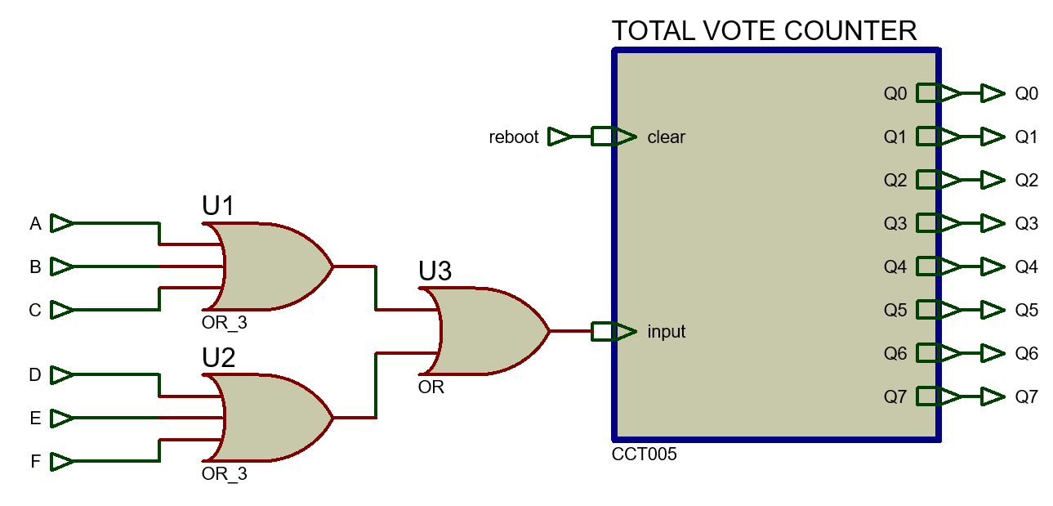
Components: EVM System
Child Sheet of the EVM

Slide 10
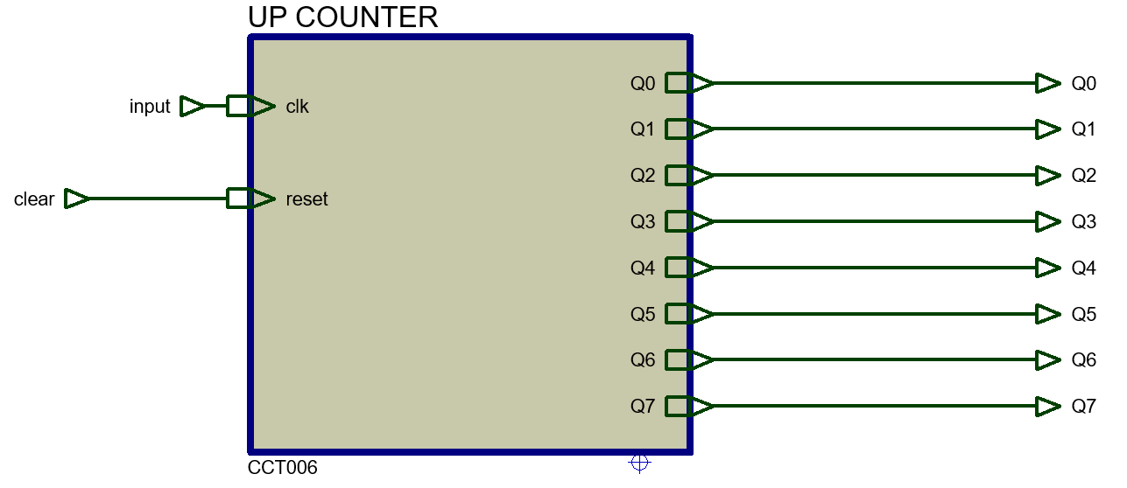
Components: EVM System
Child Sheet of the Total Vote Counter

Slide 11
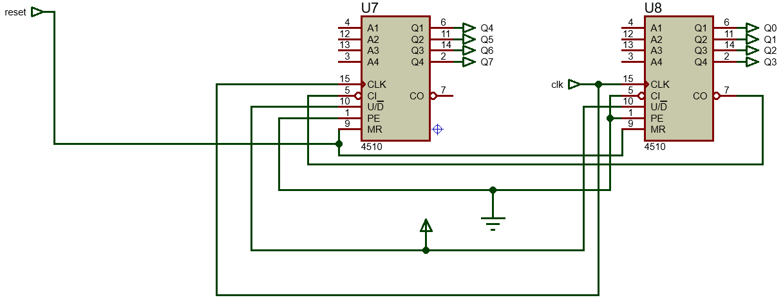
Components: EVM System
Child Sheet of the Up Counter

Slide 12
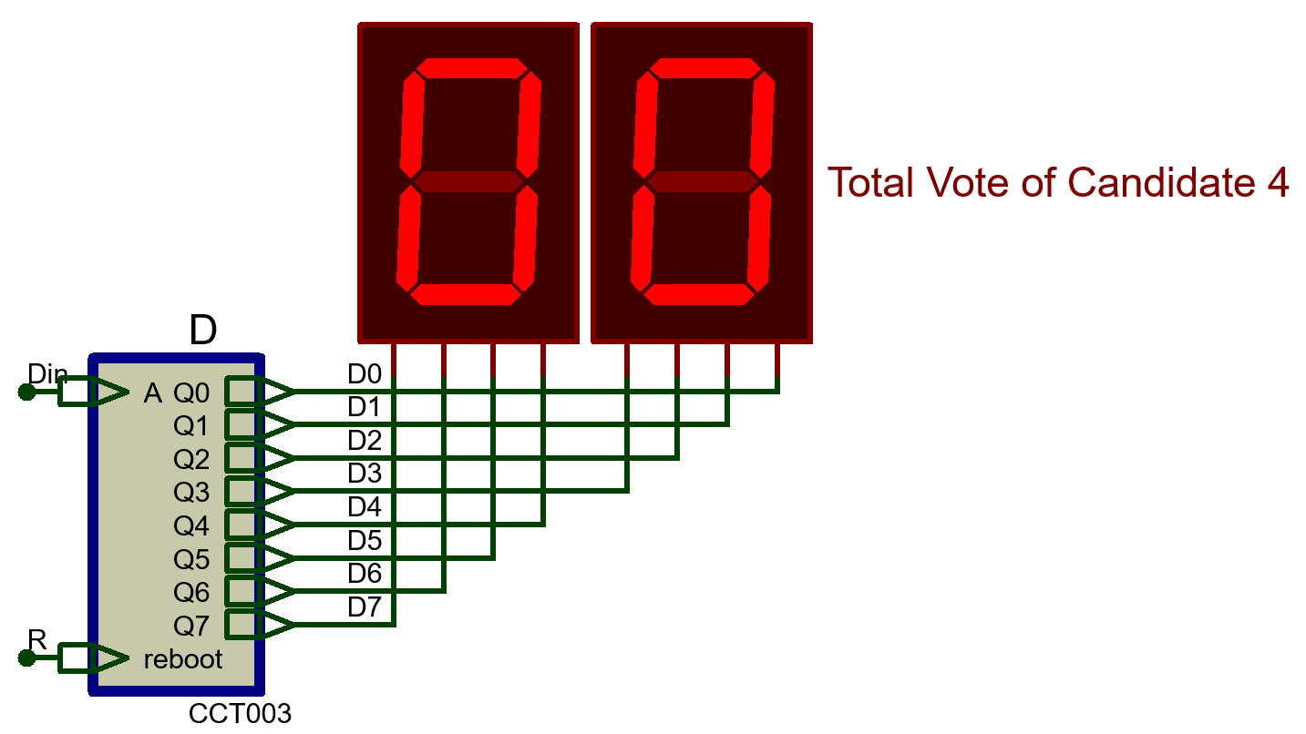
Components: Individual Vote Counter
Counts the votes of individual participants in the electoral system

Slide 13
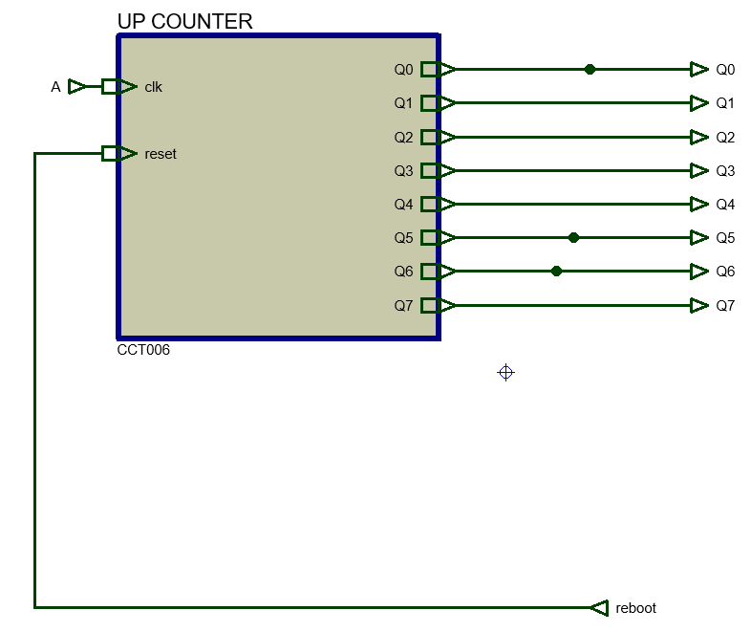
Components: Individual Vote Counter
Child Sheet of the Individual Vote Counter

Slide 14
Components: Individual Vote Counter
Child Sheet of the Up Counter

Slide 15
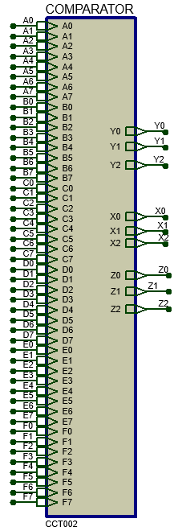
Components: Comparator
- Compares the votes that the individual members got -
- Helps in finding out the Winners -

Slide 16
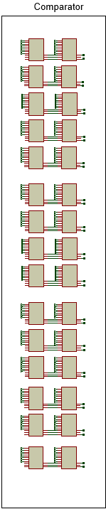
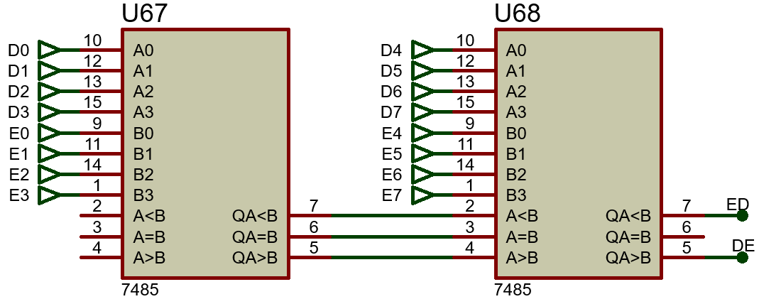
Components: Comparator
Child Sheet of the Comparator
Main Comparator Part
Magnified View
15 pairs of such cascaded comparators are present in the Main Comparator

Slide 17
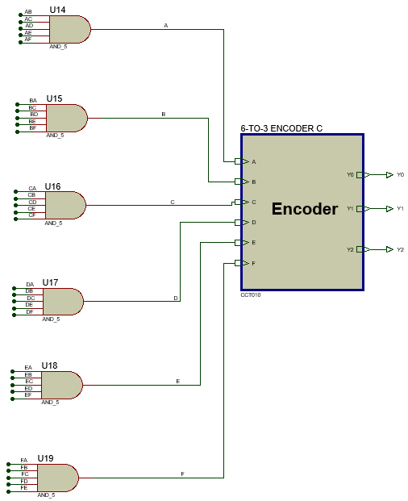
Components: Comparator
Child Sheet of the Comparator
In Case of The Chairman:

Slide 18
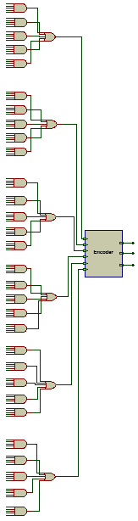
Components: Comparator
Child Sheet of the Comparator
In Case of The Vice-Chairman:

Slide 19
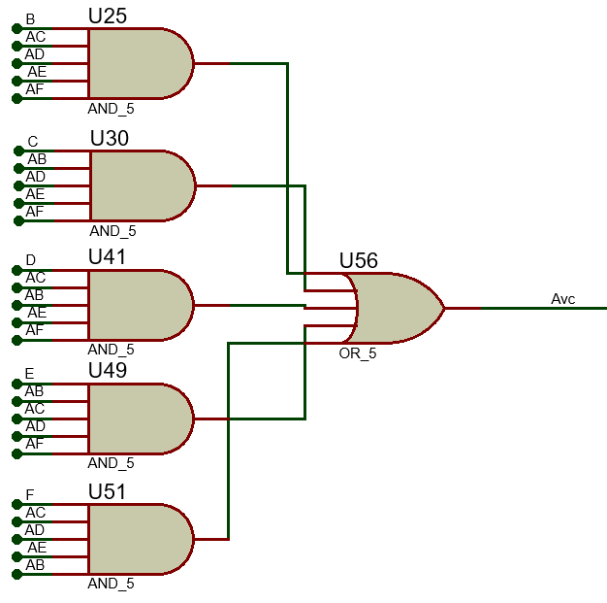
Components: Comparator
Child Sheet of the Comparator
In Case of The Vice-Chairman:
Magnified View
This circuit combination is repeated six times in the circuit and connected to each of the inputs of the Encoder

Slide 20
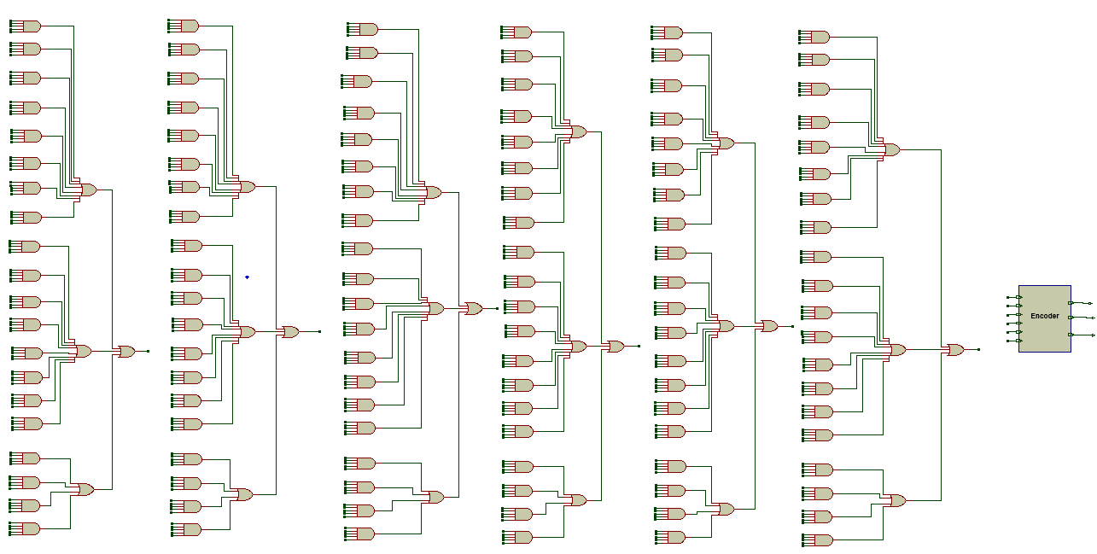
Components: Comparator
Child Sheet of the Comparator
In Case of The Secretary:

Slide 21
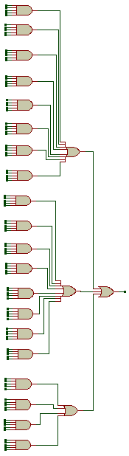
Components: Comparator
Child Sheet of the Comparator
In Case of The Secretary:
Magnified View
This circuit combination is repeated 6 times and the 6 outputs are connected as the 6 inputs of the Encoder

Slide 22
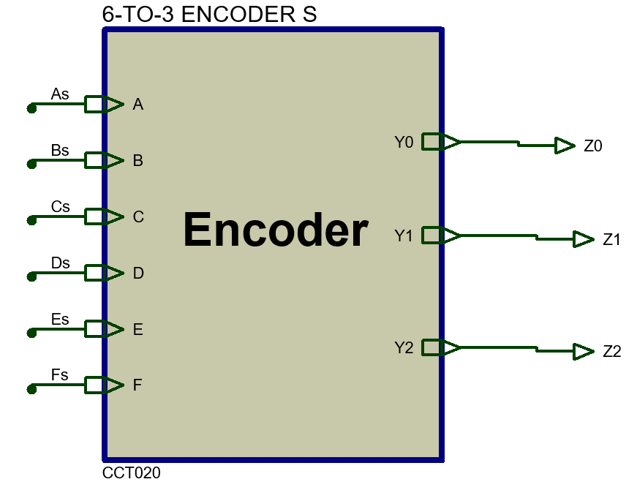
Components: Comparator
Child Sheet of the Comparator
Encoder For all 3 Winning Candidates:

Slide 23
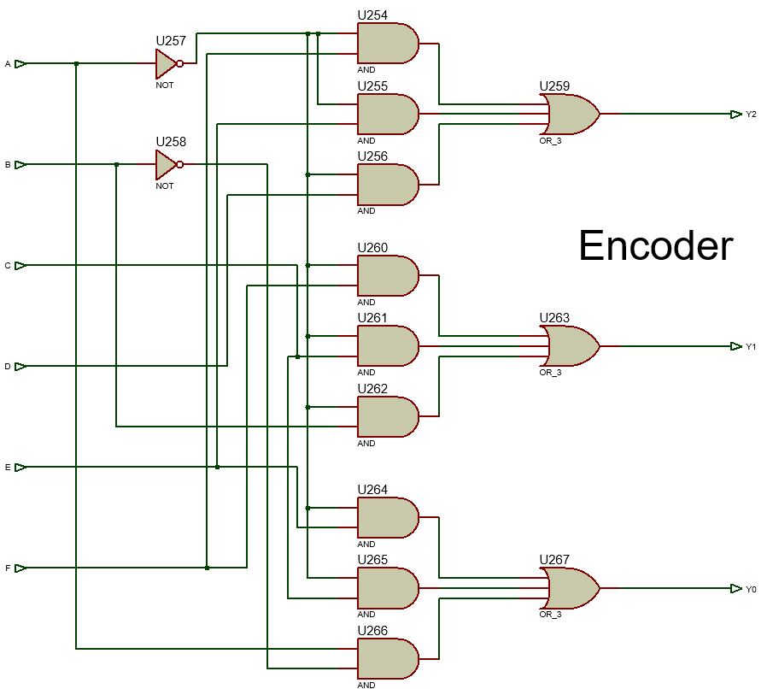
Components: Comparator
Child Sheet of the Comparator
Child Sheet of the Encoder

Slide 24
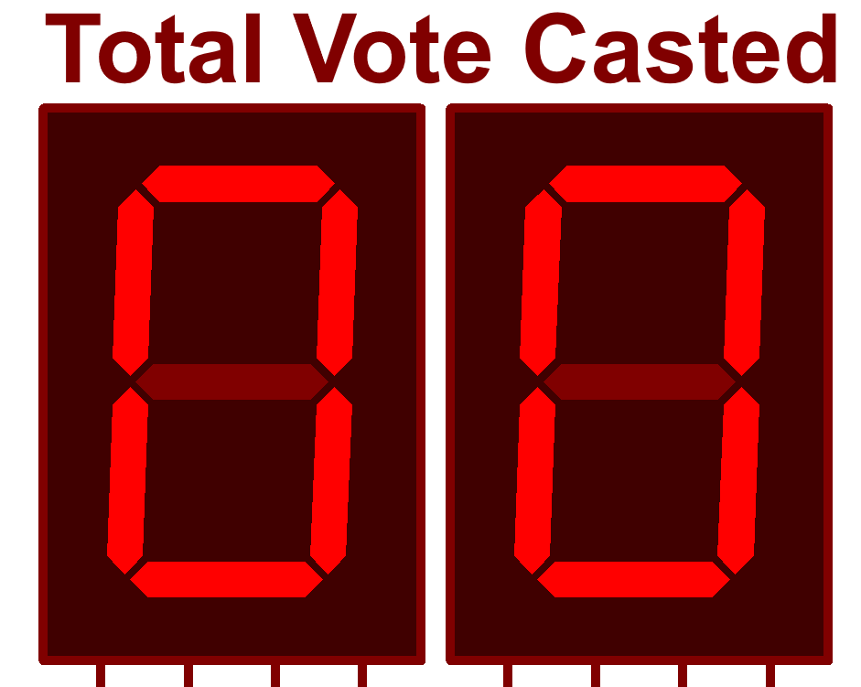
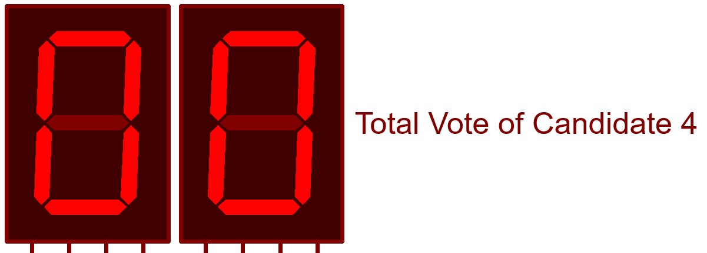
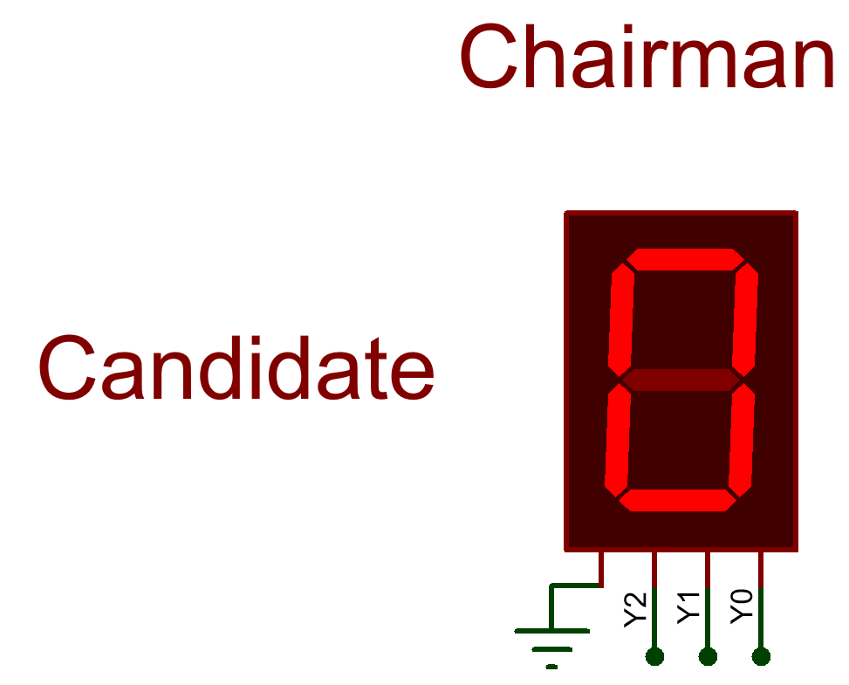
Components: 7 Segment Display
7 Segment Displays for
Total Number of Votes Casted
Total Number of Votes for an Individual Candidate
Winner Candidate Number

Slide 25
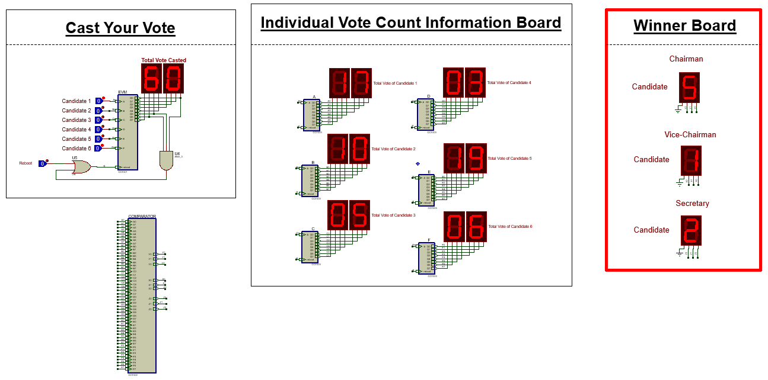
Result

Slide 26

Result: If number of vote is same

Slide 27
Strengths of the Project
Why the project stands out…
Logical and Basic Design
1
Logical and straightforward approach for the given problem
Efficient and Simple
2
Efficient use of resources without unnecessary complexity
Flexibility
3
Can take up to 256 votes by changing the inputs of the AND gate in the counter

Slide 28
Weaknesses of the Project
1
2
Limited application and usage
Use of a lot of logic gates which might result in delays

Slide 29
Impacts of the Project
Transparency
Enhancing Transparency and Trust of the voting process as a whole
Wider Application
EVMs introduced in Bangladesh, potential for broader application in elections
Fairness
Fair elections by letting majority votes determine true representation
Machine voting
System development in Bangladesh sparks tech innovation, societal benefits initiative
Efficiency
The system enhances efficiency, replaces manual counting, reducing errors

Slide 30
Future Works of the Project
Security Measures
Scalability
Enhancing security against cyber threats in future election systems
The system could be tested and modified for larger elections with more voters and candidates
Integration with Other Systems
User Interface
The system could be integrated with other systems (like voter registration databases) to streamline the entire electoral process
The user interface will be improved to make it more user-friendly and accessible to all voters

Slide 31
Thanks
Everyone!
Feel Free to Ask Questions…

